Slide 1
Proofs and Runtime

Slide 2



Proof Review
Prove by contradiction: if n² is odd, then n is odd.
Assume that n² is odd and n is even.
n = 2k
Therefore, n² = 4k², which is even. Contradiction!
Prove by contradiction: there are an infinite number of primes.
Assume there are a finite number of primes.
Therefore, there is a largest prime, p.
p! is divisible by all primes ≤ p
Therefore p!+1 is divisible by no primes ≤ p
Every number has a prime factorization, so either p!+1 is prime (and larger than p) or its prime factorization contains primes only larger than p. Contradiction!

Slide 3
Proof Review
Prove or disprove: for any sets A, B, and C, if A x C = B x C, then A = B
Recall: A x B = { ⟨a, b⟩ : a ∈ A and b ∈ B }
Proof attempt:
Assume A x C = B x C, but A ≠ B
There must be an element in one of A or B which is not in the other set.
Wlog, assume a ∈ A, but a ∉ B
Choose an arbitrary element c ∈ C.
⟨a, c⟩ ∈ A x C, but ⟨a, c⟩ ∉ B x C, contradiction!
Are there any holes in the proof?

Slide 4
Proof Review
We’re assuming there is an element from C to take!
The proof works fine, except when C = φ
This identifies what our counter-example for the problem should be!
Let A = {1, 2}, B = {2, 3}, and C = φ. A ≠ B, but A x C = B x C = φ

Slide 5
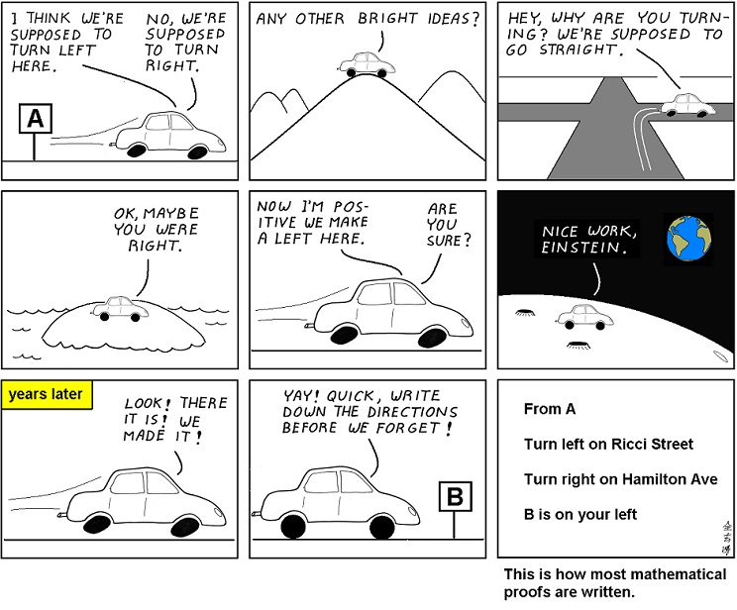
Abstruce Goose #230
After working on this proof for years, I have finally decided that it IS, in fact, obvious.

Slide 6
Proof Tips
Run through some examples. This will help convince yourself the claim is true, as well as give an intuitive understanding for why it is true.
Use the definition to translate a statement into mathematical form, when possible. This allows you to use the many rules of arithmetic to help prove it.
When doing a proof by contradiction, make sure you are assuming the logical opposite. Make a truth table if you have to.
Finding a proof is not a straight line from A to B. Even the most experienced research scientists take wrong turns. Just keep deriving stuff until you get what you need.
If you don’t know whether to prove or disprove a statement, follow your intuition. If you fail, you probably learned something about the problem: use this and try the other path.

Slide 7
Prove: Any 2^{n} x 2^{n} chessboard with one square removed can be tiled by 3-square L-shape pieces, ∀n ≥ 1
Base Case:
Inductive Hypothesis: The claim is true ∀n : 1 ≤ n ≤ k
Inductive Step: Consider n = k+1.
Split the board in four 2^{k} x 2^{k} quadrants.
Tile the quadrant with the missing square (by the I.H.)
Of the 4 center squares, remove 1 per remaining quadrant, tile the rest by the I.H.
Tile the 3 removed squares with one piece.

Slide 8


Proof by Induction
Find the flaw in the proof that a^{n} = 1, for all non-negative integers n and all non-zero reals a.
Base Case: a⁰ = 1
Inductive Hypothesis: a^{n} = 1, for all n ≤ k
Inductive Step: a^{k+1} = $\frac{ak ∙ ak}{ak−1}$ = 1, by the inductive hypothesis
To prove k+1, we are referring to k-1.
This falls apart when we let k = 0, because it refers to a⁻¹, which we haven’t proven (and can’t).
We would have to show a second base case to make this work.

Slide 9
Recurrence Relations
Mergesort( A[1:n] )
If (n == 1) then Return A
B = Mergesort( A[1:n/2] )
C = Mergesort( A[n/2+1:n] )
Return Merge(B, C)
How do you analyze the runtime of a recursive function?
f(n) = 2 ⋅ f(n/2) + Θ(n), f(1) = Θ(1)
We need to solve the recurrence relation!

Slide 10

Mergesort
f(n) = 2 ⋅ f(n/2) + x ⋅ n, f(1) = y
Hypothesize that f(n) ≤ c ⋅ n log n, for all n ≥ 2
Base Case: We need f(2) = 2 ⋅ y + 2 ⋅ x ≤ 2 ⋅ c. Choose c to be ≥ x + y
Inductive Hypothesis: Assume f(n) ≤ c ⋅ n log n, for all n: 2 ≤ n ≤ k
Inductive Step: f(k+1) = 2 ⋅ f($\frac{k+1}{2}$) + x ⋅ (k+1)
≤ 2c ⋅ $\frac{k+1}{2}$ log $\frac{k+1}{2}$ + x ⋅ (k+1), by the inductive hypothesis.
= c ⋅ (k+1) [ (log (k+1) ) -1 ] + x ⋅ (k+1)
= c ⋅ (k+1) ⋅ log (k+1) + (x – c) ⋅ (k+1)
We want this to be ≤ c ⋅ (k+1) ⋅ log (k+1), which is true if c ≥ x.
It is, since we already chose c to be ≥ x + y. Proven!

Slide 11
Mergesort, cont.
Does this prove that Mergesort takes Θ(n log n)?
No, we only showed O(n log n). We’d need another proof to show Ω(n log n)!
Is it valid to use n = 2 as the base case?
Yes, because O-notation asserts the claim is true for all n ≥ n₀. We can choose n₀ = 2.
What would have happened if we tried n = 1 as our base case?
It would have failed, since 1 log 1 = 0, and our algorithm doesn’t take 0 time when n = 1. The claim is not true when n = 1.
We generally don’t use induction to prove recurrences because it is difficult, and you need to already know the inductive hypothesis to even get started.

Slide 12
Solve-by-Tree
f(n) = 2 ⋅ f(n/2) + cn, f(1) = d
How much work at each level?
cn
How many levels?
log n
Total work = Θ(n log n)
n
n/2
n/2
n/4
n/4
n/4
n/4
…
1
1
1
1
1
1
1
1

Slide 13

Abstruse Goose #353

Slide 14

Master Theorem
Master Theorem can solve (almost) any recurrence relation of the form f(n) = a ⋅ f($n/b$) + g(n), for constants a ≥ 1 and b > 1.
Compare g(n) with $n{\log{a}}/{\log{b}}$
Case 1: If g(n) = Θ($n{\log{a}}/{\log{b}}$), then f(n) = Θ(g(n) ⋅ log n)
f(n) = 2 ⋅ f( $n/2$ ) + cn
f(n) = Θ(n ⋅ log n)

Slide 15

Master Theorem, Cases 2 and 3
Case 2: If g(n) = Ω($n({\log{a}}/{\log{b}})$ ⁺ ^{ε} ) for some ε > 0, then f(n) = Θ(g(n))
Ω($n{\log{a}}/{\log{b}}$ ) is true when case 1 is true, so we’re (kind of) saying that g(n) must be strictly larger.
What should case 3 be?
Case 3: If g(n) = O( $n({\log{a}}/{\log{b}})$ – ^{ε} ) for some ε > 0, then f(n) = Θ($n{\log{a}}/{\log{b}}$ )

Slide 16

Master Theorem Analysis
n
g(n)
a ⋅ g( n/b )
a² ⋅ g( n/b² )
a^{logb n}
= n^{logb a}
= $n{\log{a}}/{\log{b}}$
n/b
n/b
…
n/b²
n/b²
n/b²
n/b²
…
…
…
1
1
1
1
1
1
1
1

Slide 17

Practice
f(n) = f($n/{2 }$) + 1
f(n) = Θ(log n)
f(n) = 8 ⋅ f($n/{2 }$) + 1000n²
f(n) = Θ(n³)
f(n) = 2 ⋅ f($n/{2 }$) + n²
f(n) = Θ(n²)

Slide 18

Limits of Master Theorem
f(n) = 2 ⋅ f($n/{2 }$) + $n/{\log{n}}$
n > $n/{\log{n}}$, so does that mean the runtime is Θ(n)?
We need g(n) = O( $n({\log{a}}/{\log{b}})$ – ^{ε} )
So we need n^{1-ε} > $n/{\log{n}}$
That means $n/{n\text{ε}}$ > $n/{\log{n}}$
Alternatively, n^{ε} < log n
…which isn’t true.

Slide 19
Interpreting Master Theorem
If the work done on the bottom level is a polynomial-factor bigger than the work on the top level, then the total work is the work on the bottom level.
If the work done on the top level is a polynomial-factor bigger than the work on the bottom level, then the total work is the work on the top level.
If the difference between the top and bottom level is greater than a constant, but smaller than a polynomial, then master theorem will not help us.

Slide 20


Solving f($n$) = 2 ⋅ f($n/{2 }$) + $n/{log n}$
n
= $n/{\log{n}}$
= $n/{(log{n})−1}$
= $n/{(log{n})−2}$
n/2
n/2
n/4
n/4
n/4
n/4
…
1
1
1
1
1
1
1
1

Slide 21


Solving f($n$) = 2 ⋅ f($n/{2 }$) + $n/{log n}$
$$\sum_{i=1}^{\log{n}}{n/i}=n\sum_{i=1}^{\log{n}}{1/i}$$
$$=n\log{(\log{n)}}$$
The runtime is Θ(n log log n)
We would have to also use solve-by-tree if we wanted to solve, for example, f(n) = f($\sqrt{n}$) + 1

Slide 22
A different form of runtime analysis
Recall that a vector (from the STL) is implemented using an array.
What is the worst-case runtime for the pushback function?
Is it O(1)?
If the array is full, we’ll need to double the size of the array, which takes Θ(n) time!
It is correct to say that pushback takes worst-case Θ(n) runtime.
This analysis seems rather unfair, given that the worst-case will happen rarely, and at predictable intervals.

Slide 23
Amortized Runtime
We could accurately say that the average runtime for pushback is O(1).
This still doesn’t capture everything: that implies that if we get bad luck, the average will be worse than O(1).
There is no luck involved: we know exactly how many inputs will be required to produce the worst-case scenario, and it will always be the same effect.
Amortized Runtime is a blend between average-case and worst-case. It is kind of the “worst-case average-case”.

Slide 24

Amortized Runtime
If the first x operations take a total of Θ(y) time, then the average time per operation is Θ($y/x$).
The amortized runtime chooses the number and sequence of operations that produces the worst-possible average runtime.
It is like the “worst-case average-case”.
Assume that the array starts at size 1, and you do n inserts. What is the amortized runtime for pushback?

Slide 25

Pushback analysis, method 1
There will be a few expensive pushbacks, when we have to resize the array.
How costly is an expensive pushback?
Θ(i), where i is the current size of the array.
How many expensive pushbacks will there be?
log n
The total runtime is $\sum_{i=1}^{\log{n}}{2i}+(n−\log{n)}=Θ(n)$
So the average time per operation is O(1). Guaranteed!

Slide 26

Pushback analysis, Method 2
Let a new “phase” start just after the array has resized.
Analyze the amortized runtime for an arbitrary phase:
The array has just grown to size n, because we inserted $1+n/2$ things.
We insert $n/2$ things this phase, all but one of them take O(1) time.
The last thing takes Θ(n) time.
Amortized runtime = $\frac{1∙n+(n/2−1)∙1}{n/2}=Θ(1)$

Slide 27

Pushback analysis, Method 3
Every time we call pushback, we pay 5 dollars.
Cheap operations only require 1 dollar, so we place the excess in a piggy bank.
When we get to an expensive operation, the last $n/2$ things have each paid 4 extra dollars.
We need to make an array of size 2n, so we have one dollar for each index we need to make: we always have enough money saved up!
5 = Θ(1), so the amortized runtime is constant.

Slide 28
Practice
We are using a Boolean array as a binary counter.
Each index starts at 0 (false), and the counter counts up in binary.
Some increments (from 1010 to 1011, for example) require only constant time.
Other increments (from 01111111 to 10000000) take a long time.
What is the worst-case runtime of our increment function?
Θ(log n), since if we insert n times, we require log n bits.

Slide 29
Amortized analysis of the Binary counter
Starting at the least significant bit, if the current bit is a 0, we flip it and stop. Otherwise we flip the 1 to a 0 and continue to the next bit.
We will always flip a single 0 to a 1.
We will flip a variable number of 1s to 0s.
We will use the piggy bank method (method 3) to solve this.

Slide 30
Practice
When we call the increment function, we pay 2 dollars. Every bit takes a single dollar to flip, from either 0 to 1 or 1 to 0.
All of the bits start at 0.
Whenever we flip a bit from 0 to 1, we spend both of our 2 dollars towards that bit. 1 dollar to cover the immediate costs, and the other dollar to be stored for when it eventually flips from 1 to 0.
Since only a single bit flips from 0 to 1 every increment, we always have enough money saved up for the 1s that flip to 0s.
Since 2 = Θ(1), this takes amortized constant time!

Slide 31

Take-Home Practice
Prove for all integers n: n is odd iff 3n+1 is even.
Use induction to prove that $\sum_{i=0}^{n}{\frac{1}{2i}}<2$
Chapter 2, exercises 3, 4, 5, 6
Challenge problem: Chapter 2, exercise 8
Solve the following recurrence relations:
$f\left(n\right)=f\left(n/4\right)+\sqrt{n}$
$f\left(n\right)=f\left(n/4\right)+1$
$f\left(n\right)=f\left(n/4\right)+\log{n}$

